Slide 1
Does expenditure affects Singapore’s education system?
Denzel See(2222840)

Slide 2
Datasets used
https://data.gov.sg/dataset/government-recurrent-expenditure-on-education-per-student
https://data.gov.sg/dataset/ite-intake-enrolment-and-graduates-by-course
https://data.gov.sg/dataset/percentage-of-p1-cohort-eligible-for-express-normal-acad-normal-tech

Slide 3
Nature of the Datasets

Slide 4
Government Recurrent Expenditure on Education Per Student
This dataset contains the :
year
type of educational institution
amount of expenditure spent per student

Slide 5
ITE - Intake, Enrolment and Graduates by Course
This dataset contains the :
year
sex of the students
course
intake amount
enrolment amount
graduates amount.
Intake: made sure to use the intake that is 3 years behind the graduate since ITE is a 3 year journey
(ie. 2016 intake, 2019 graduate)

Slide 6
Percentage of P1 Cohort Eligible for Secondary School
This dataset contains the :
year
percentage of primary 1 students that are eligible for secondary school

Slide 7
The Process

Slide 8
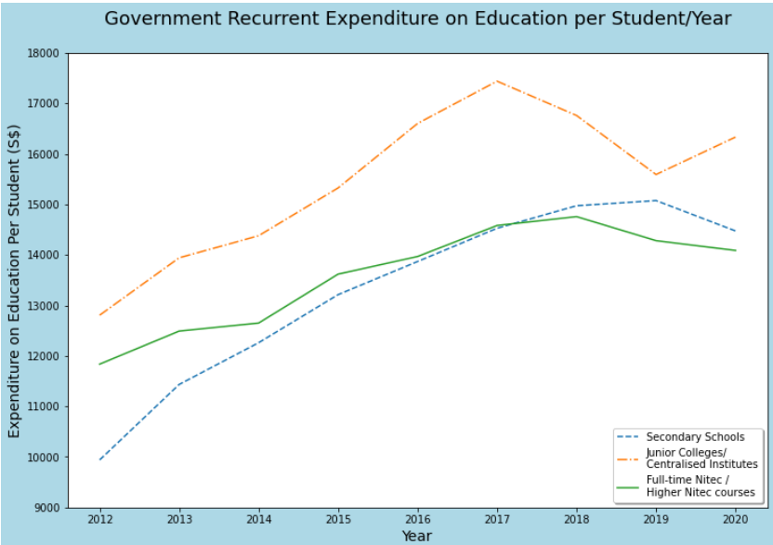
Government Recurrent Expenditure on Education Per Student
Line graph to :
show the trends of the
division of expenditure
show relationship
between expenditure

Slide 9
Process:
Filtered data through years 2012-2020 using np.isin.
Further filtered the data into their individual types of educational institution.
Called the expenditure column and plot it into a line chart

Slide 10
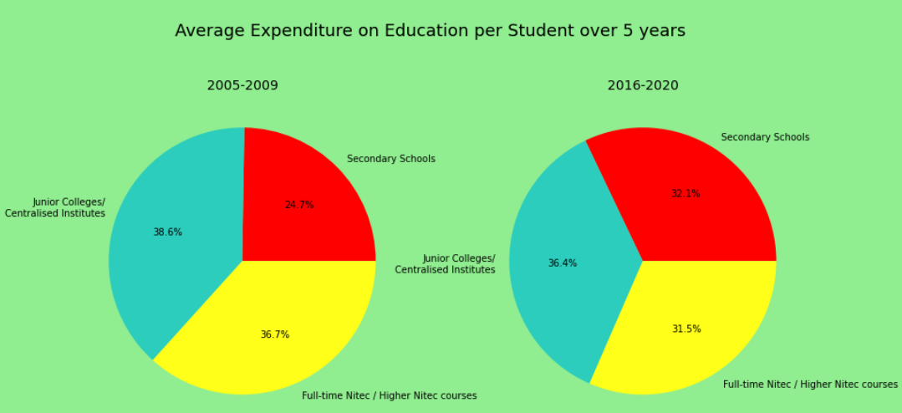
Pie chart to compare how the types of educational institute spends over two different 5 year periods.
Same process as before however this time took two sets of data:
The years 2004-2009
The years 2016-2020

Slide 11
Insights
Expenditure per student of Secondary schools and ITE were about the same while JC/CI was higher.
Secondary schools and ITE expenditure per student has become stagnant after increasing gradually over a period of 5 years.
JC/CI’s expenditure however is not stagnant, peaking in the late periods of 2016 and dropped until 2019 where it started to rise again.
From the pie chart : Secondary schools have gotten an increased attention from the government as the expenditure per student increased by 7% as compared to others.

Slide 12
ITE - Intake, Enrolment and Graduates by Course
Boxplot: compares the intake to graduation.
Process:
Took the intake data out, filtering the years 2014-2017 using np.isin
Initialize separate variable for the graduates, filtering the years 2017-2020.
Filtered the genders by MF

Slide 13
Initialized four variables and sorted the years into those variables for intake and graduates.
Took out the intake and graduate numerical value and plotted the boxplot.
Used 2x2 subplot to plot four separate boxplots with the intake batches and their respective graduates

Slide 14
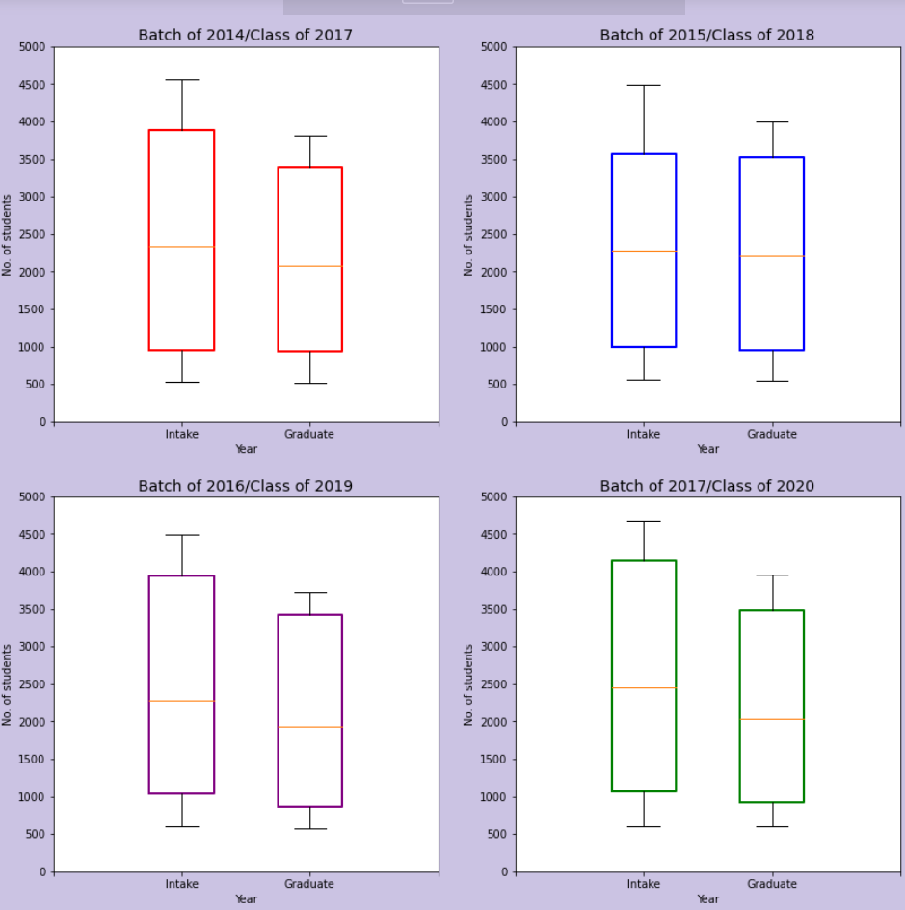

Slide 15
Insights
Graduate is generally always lesser than the intake and the 3rd quartile is almost always much lower than the intake’s.
However, for the 2015 batch, the 3rd quartile and median of the box of the graduates were almost identical to the intake’s.
Aside from that, the graduate to intake difference is generally the same and stagnant
Similar to the expenditure per student which could imply that the expenditure per student may have an effect on the graduation percentage .

Slide 16
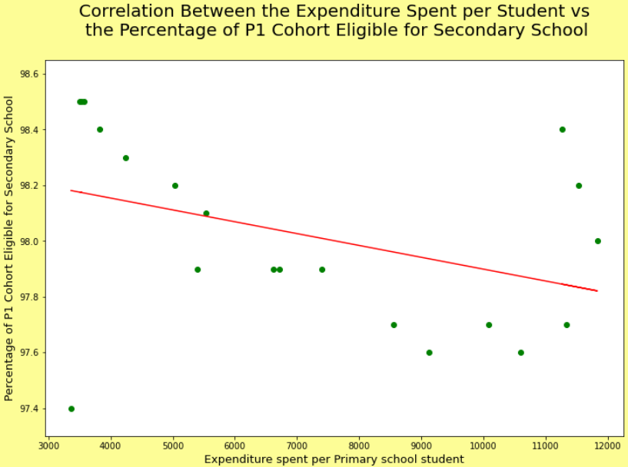
Percentage of P1 Cohort Eligible for Secondary School
Scatterplot:
percentage of primary 1 cohort eligible for secondary school
vs
the government’s expenditure per primary school student.

Slide 17
Process :
Filter the years of the data using np.isin since one dataset only had data from 2002-2020.
Further filtered data so that only Primary School data is taken
Took out the numerical value, calling the column header ‘percentage’
Plotted the scatterplot, x value being the expenditure and y value being the percentage.

Slide 18
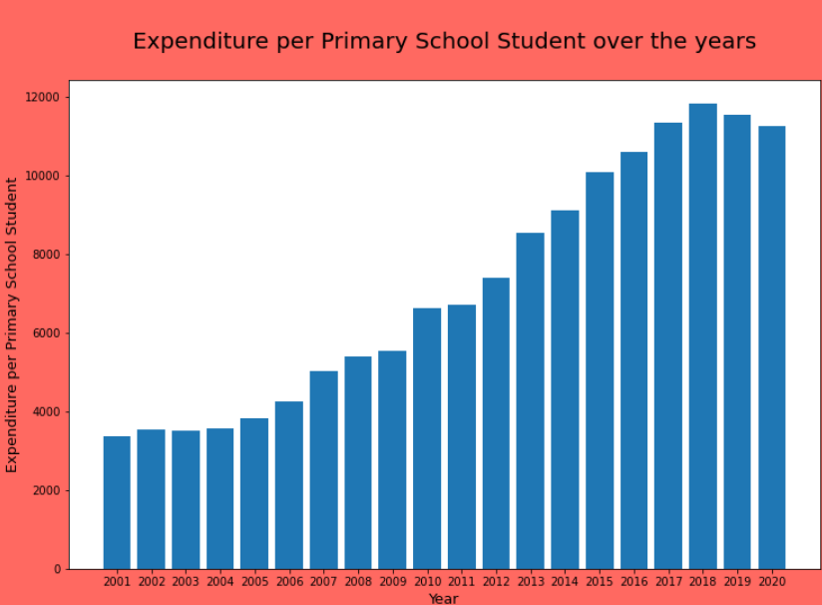
Bar graph :
show the trend of how the expenditure per primary school
student changes over the years
Process :
Used the already filtered data to plot the bar graph

Slide 19
Insights
From the scatterplot :
Surprising downward trend between the percentage and expenditure, with the outlier of the last three years having a high percentage of about 98%-98.4%.
Expenditure is increase while percentage is seemingly decreasing.
Inflation factor :
The time period of 2001-2020 is too little for inflation to actually have a huge impact in the expenditure
$1 in 2001 being $1.46 in 2020.

Slide 20
Surprising since from a logical standpoint the higher expenditure should have an increase / no correlation between the percentage eligible for secondary school.
From the bar graph :
Expenditure per primary school student have a increasing trend from 2001-2020.
Parabolic shape, peaking at 2018 and now have a slow gradual decrease from 2018-2020
Shows that the government is either planning to lower primary school expenditure or keep it stagnant.

